Slide 1
Point Cloud Primitive Fitting
Marc-André Piché
Sreya Francis
Notes:
Be careful, this might go so fast we will burn your retina....

Slide 2
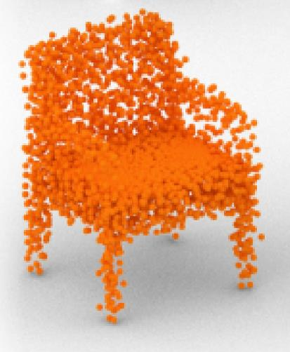
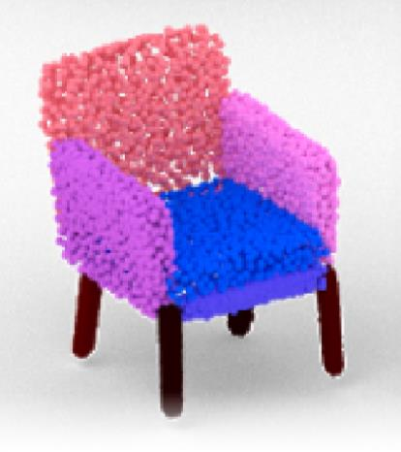
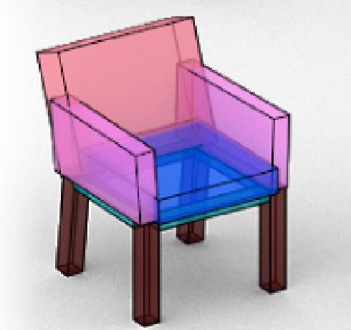
The Shape of Things
images from :
arXiv:1908.00575v1
Notes:
In its most simple form, this here is what we want to do
Take a point cloud and find how we can decompose it into simple shapes
Not objects, or Labels … SHAPES

Slide 3
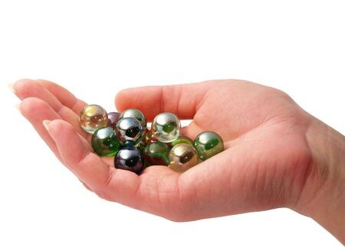
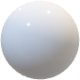
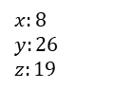
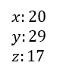
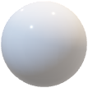
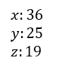
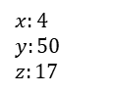
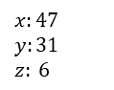
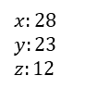
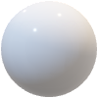
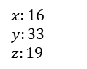
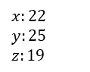
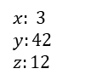
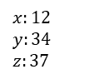
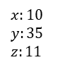
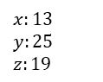
A handful of coordinates
Unordered and unstructured list
Sparsity (challenge for CNN)
Density variability
Occlusion
Huge data size
$$x:4$$
$$y:50$$
$$z:17$$
$$x:8$$
$$y:26$$
$$z:19$$
$$x:16$$
$$y:33$$
$$z:19$$
$$x: 3$$
$$y:42$$
$$z:12$$
$$x:20$$
$$y:29$$
$$z:17$$
$$x:10$$
$$y:35$$
$$z:11$$
$$x:36$$
$$y:25$$
$$z:19$$
$$x:22$$
$$y:25$$
$$z:19$$
$$x:47$$
$$y:31$$
$$z: 6$$
$$x:13$$
$$y:25$$
$$z:19$$
$$x:12$$
$$y:34$$
$$z:37$$
$$x:28$$
$$y:23$$
$$z:12$$
Notes:
Let’s quickly state why point clouds are so troublesome compared to images.
You wouldn’t be able to tell a shape with a handful of coordinates.
They are unevenly distributed and cannot really be sorted as they can be anywhere in space
The best we can do is build a graph of neighbors, but that’s really expansive ---

Slide 4
A handful of coordinates
Unordered and unstructured list
Sparsity (challenge for CNN)
Density variability
Occlusion
Huge data size
$$x:4$$
$$y:50$$
$$z:17$$
$$x:8$$
$$y:26$$
$$z:19$$
$$x:16$$
$$y:33$$
$$z:19$$
$$x: 3$$
$$y:42$$
$$z:12$$
$$x:20$$
$$y:29$$
$$z:17$$
$$x:10$$
$$y:35$$
$$z:11$$
$$x:36$$
$$y:25$$
$$z:19$$
$$x:22$$
$$y:25$$
$$z:19$$
$$x:47$$
$$y:31$$
$$z: 6$$
Current methods :
Voxels
2D projection with 2D convolution
3D convolution (expensive)
Directly work on cloud (PointNet)
$$x:13$$
$$y:25$$
$$z:19$$
$$x:12$$
$$y:34$$
$$z:37$$
$$x:28$$
$$y:23$$
$$z:12$$
Notes:
Several lines of solutions have been proposed to address these problems, each with their own drawback

Slide 5
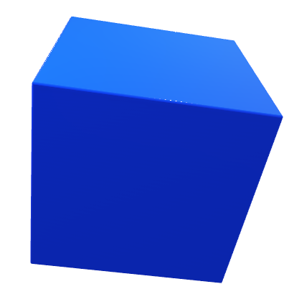
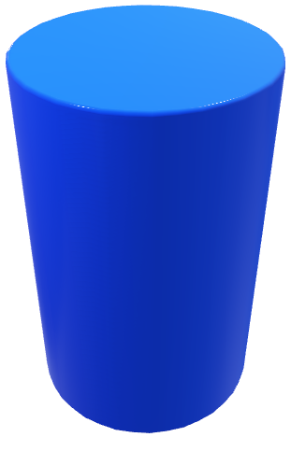
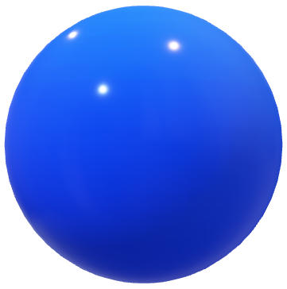
How best to represent a shape ?
Mathematical accuracy
Fast computation
How to represent any shape ?
Notes:
!!!!!!!!!!!!
First step in our project is choosing which primitives we will use.
Planes and cylinders are pretty underwhelming, and we wanted more
So how to show that the network has an inner REPRESENTATION of the primitive ->"here is a 2x3x1 cuboid" ... here is a cylinder... etc
But also, how to take advantage of discrete geometrical representation's advantage of fast computation. (ie meshes)
-------------

Slide 6
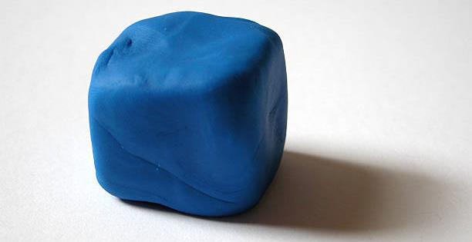
A more flexible primitive
Notes:
What we need is a more flexible primitive
A basic shape, that will cover most of our needs --

Slide 7
How best to represent a shape ?
Mathematical accuracy
Fast computation
How to represent any shape ?
Parametrization of course !
Notes:
A shape that can lie between primitives
A combination of their properties
!!!!!!!!!!!!

Slide 8
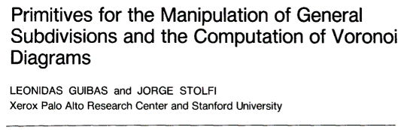
Quad-Edge data structure*
*
Notes:
Taking inspiration from the Quad-Edge data structure where you have links to vertex edges and faces ---

Slide 9
PrimBlock
Parametric Modeling
Fast distance computation
Notes:
We put alot of effort into finding the most flexible parametric primitive
That we call a Primitive Block
And also that its implementation provides us some advantages
for exemple we can compute distances to a quad very fast as this data-structure is similar to an Octree

Slide 10
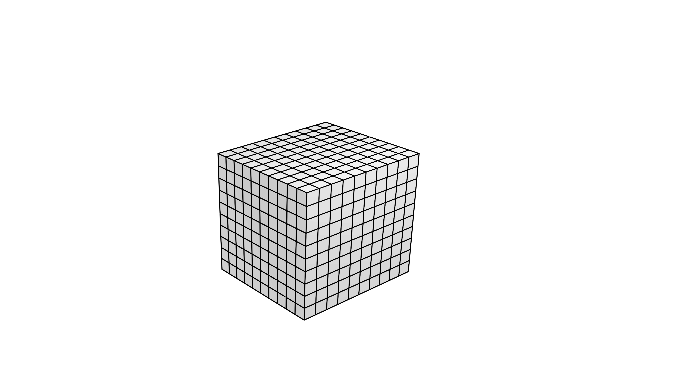
Notes:
The result is a quad mesh that we can easily morph into other primitives of the same genus

Slide 11
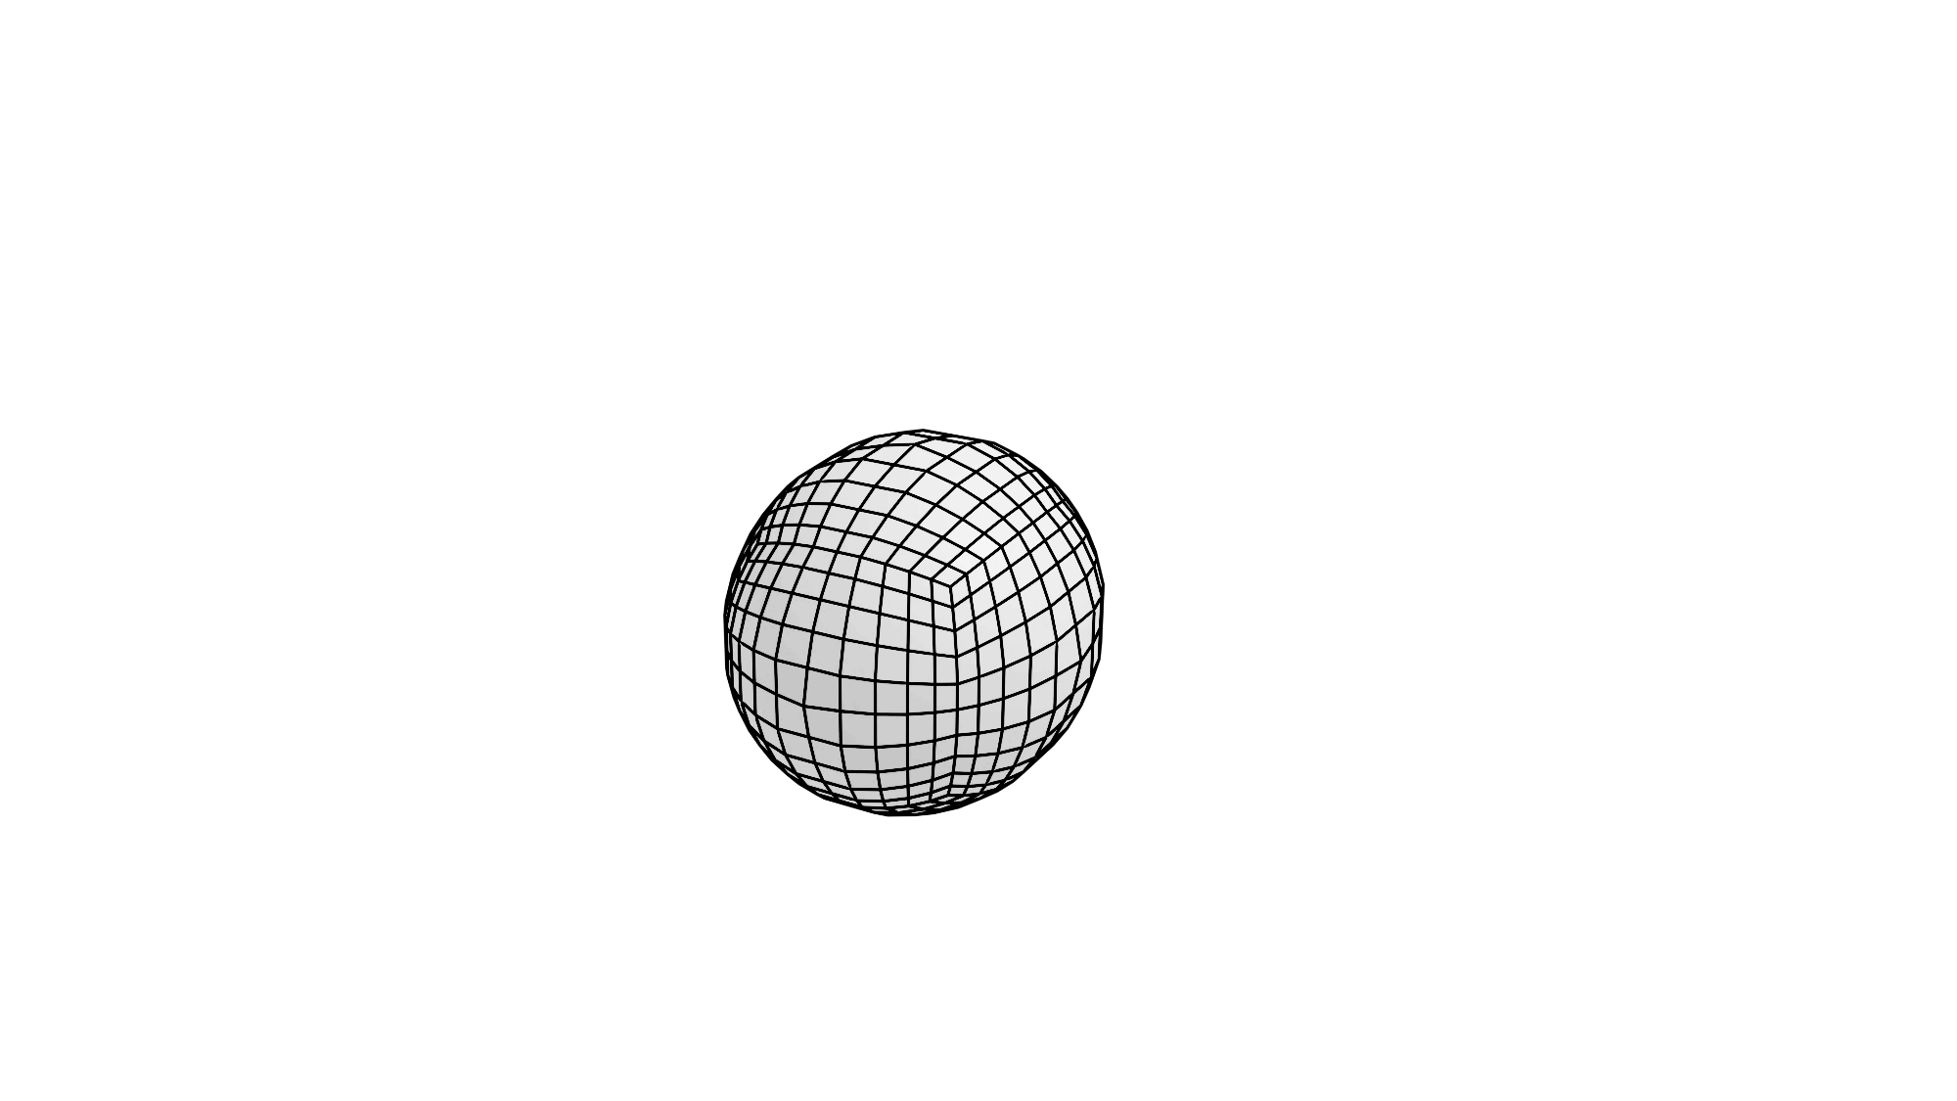
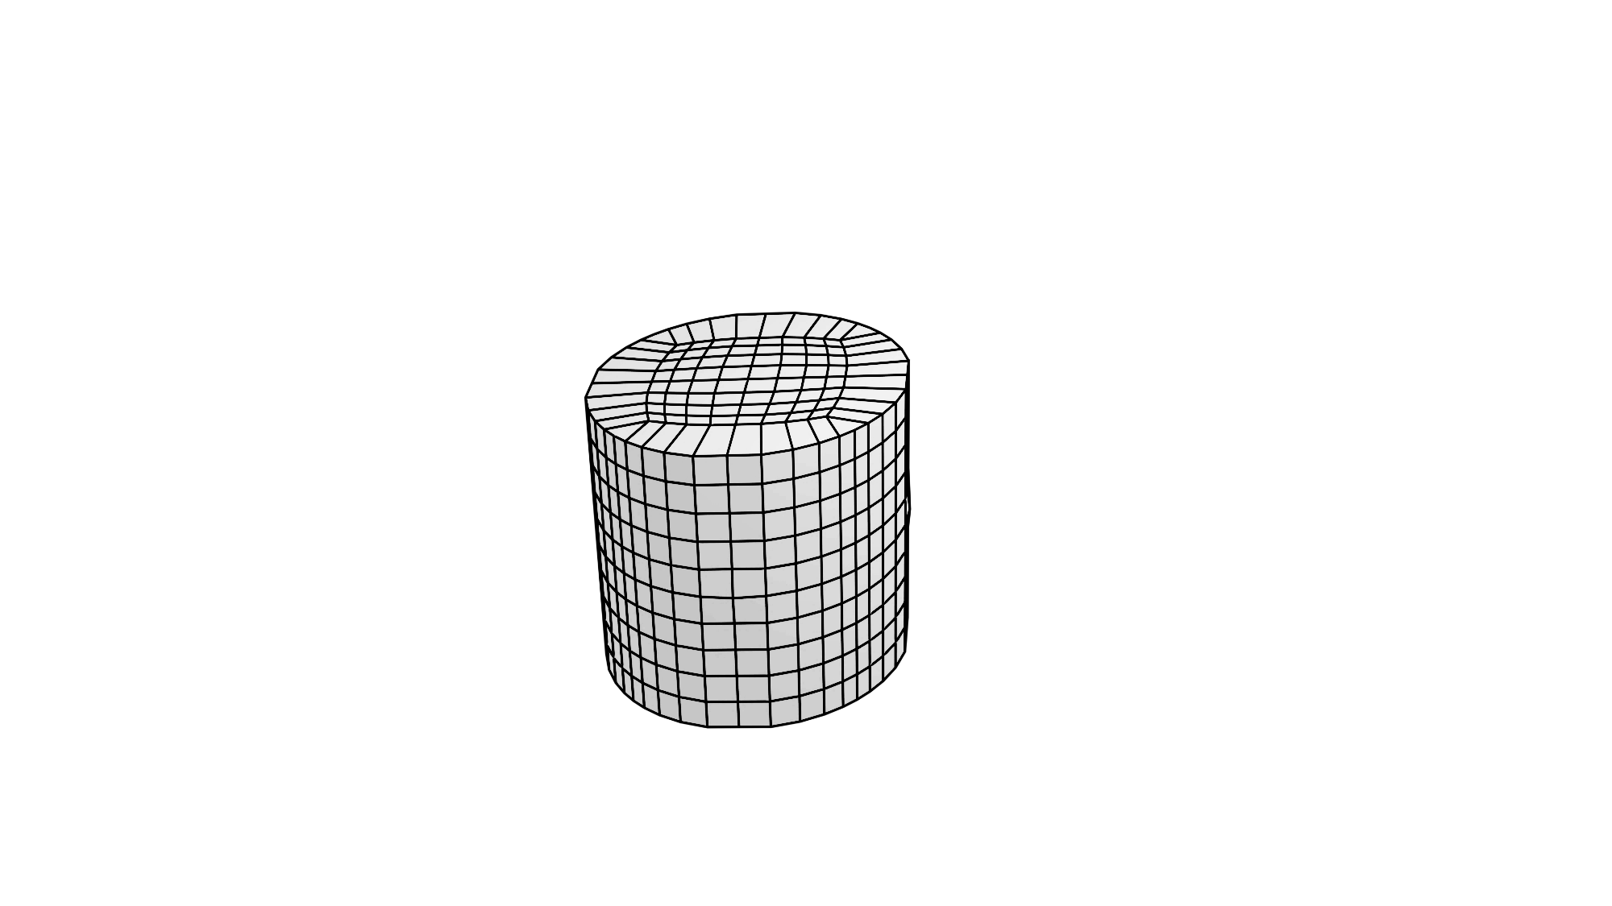

Round Corners
Round Edges
Notes:
Simply by having control over the roundness corner and edges

Slide 12



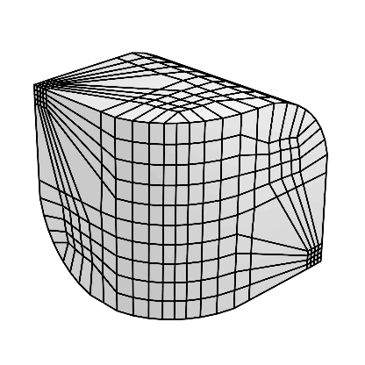
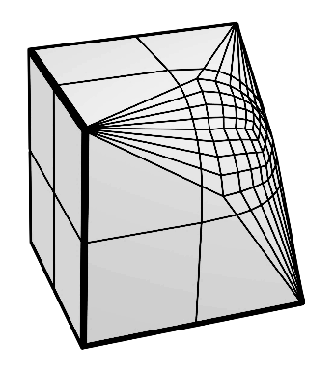
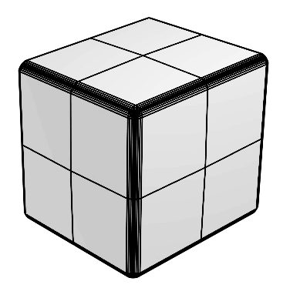
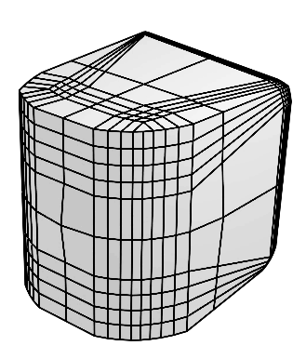
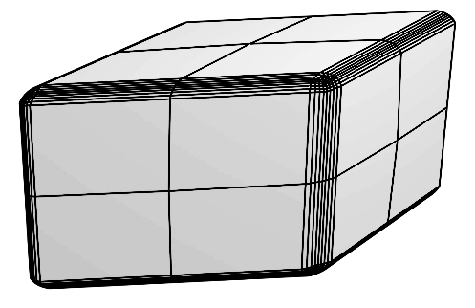
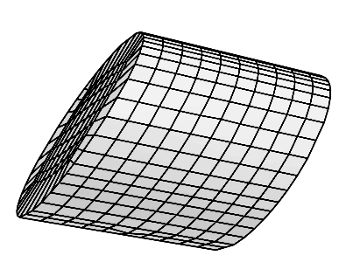
Notes:
Allowing for a whole of interesting shapes
All basic, but much more expressive than planes and cylinders

Slide 13
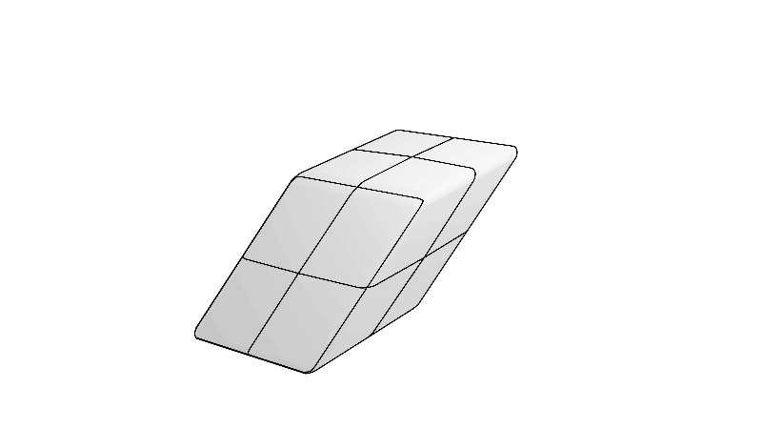
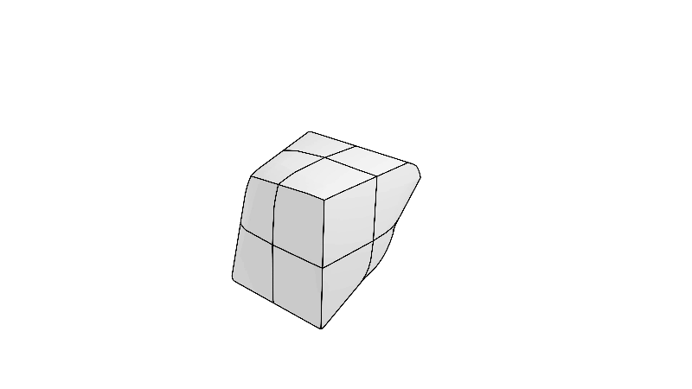
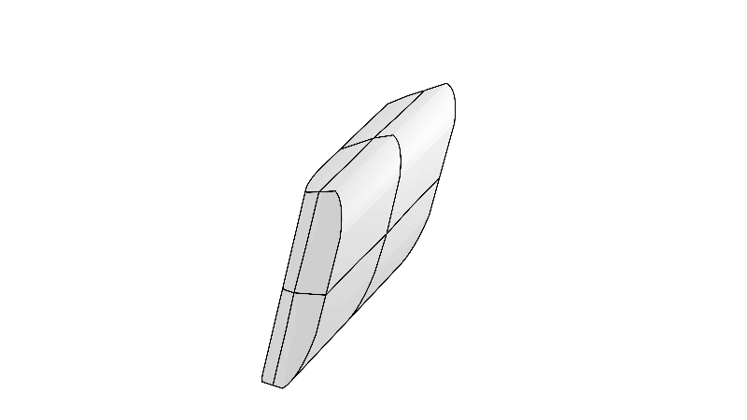
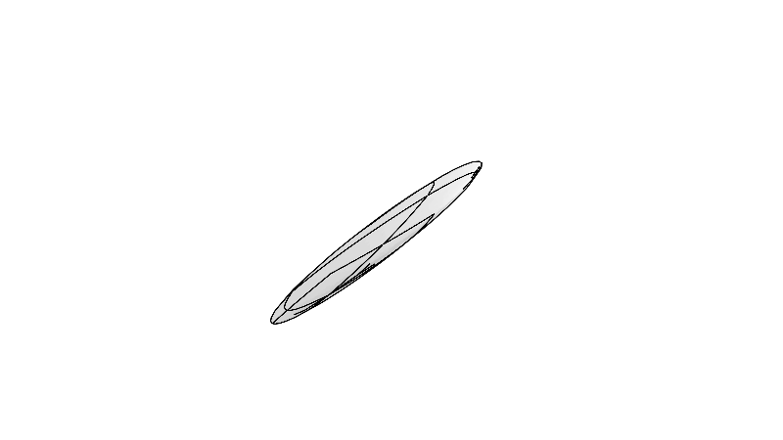

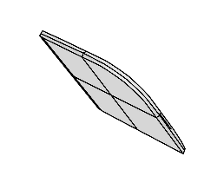
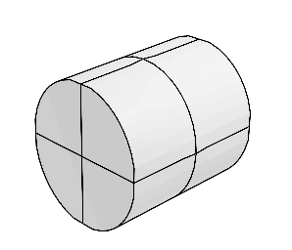
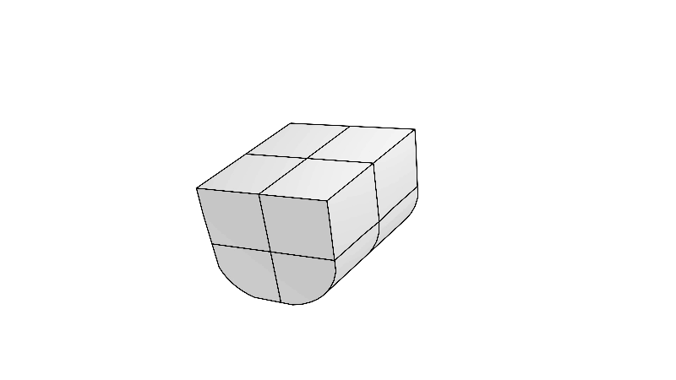
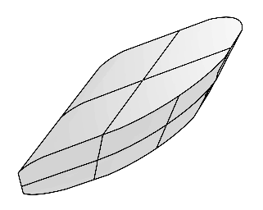
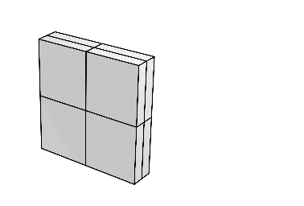
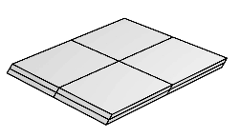
Notes:
Considering Transformations in our parameters expands our Primitive Block even more.

Slide 14
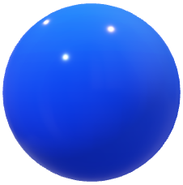

Self-supervised learning approach
PointNet
Encoder
?
Notes:
These parameters can be learned with a random dataloader as self-supervised learning ---

Slide 15
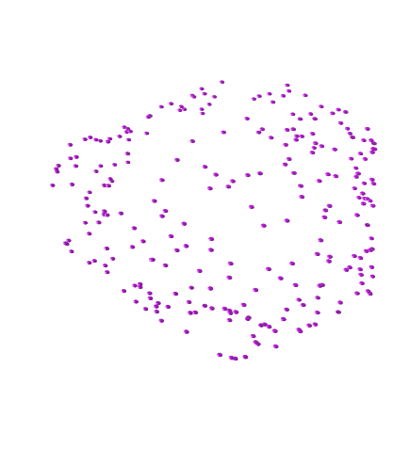
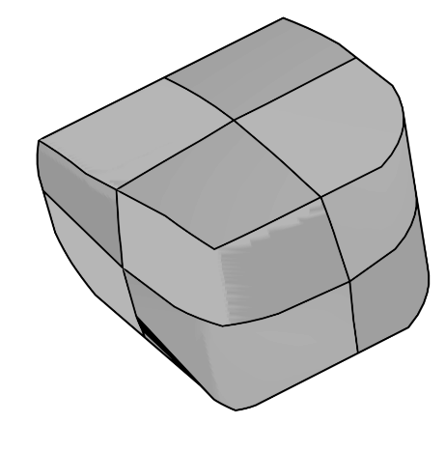
PointNet
Encoder
Notes:
Where you want to predict the parameters of the parameters of the shape a cloud belongs too

Slide 16

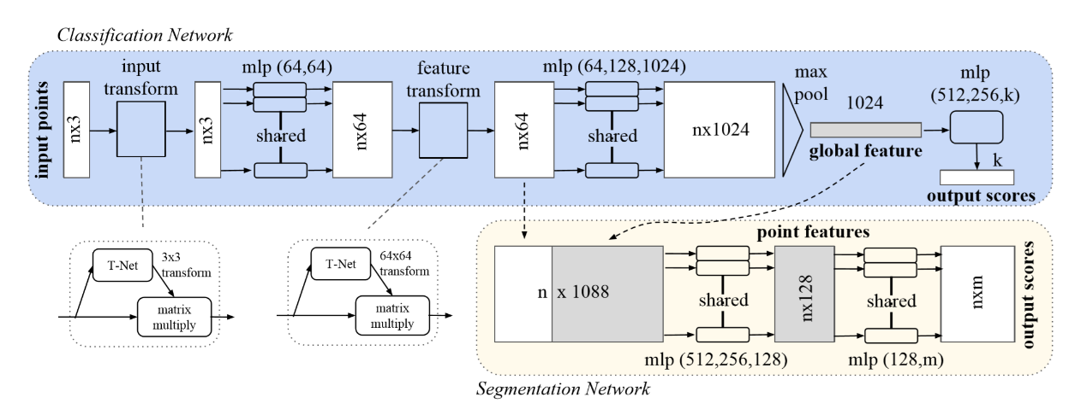
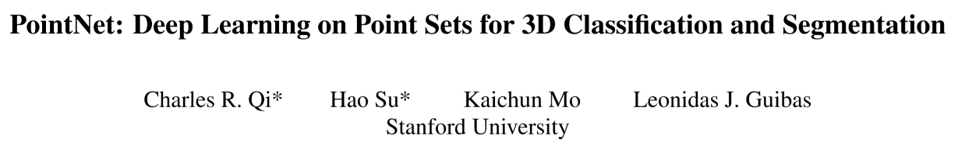
Leaf Node
Basically : one neuron per point
crude but effective
Notes:
Eventually this will be leaves of our segmentation tree
And we used PointNet for this as it easy to implement and still one of the best neural networks for pointclouds

Slide 17
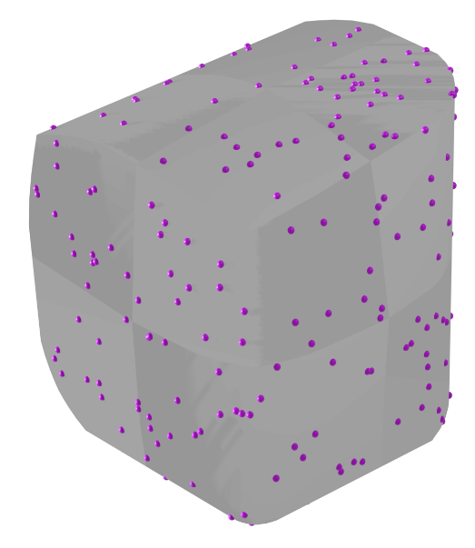
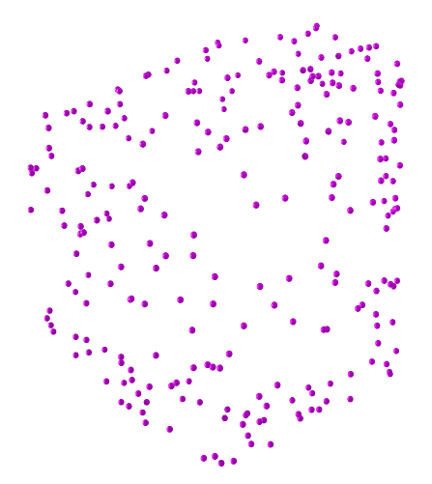


Notes:
What we do in truth is finding the projection onto our Primitive Block and then compute the inverses to find our solution
Because we these transformation matrices as part of the PointNet design

Slide 18
Notes:
Say we receive a single point ---

Slide 19
Notes:
we obviously can’t tell which shape it belongs to ---

Slide 20
Notes:
At which point can you guess what the shape is ?

Slide 21
Notes:
3 points could be a shape

Slide 22
Notes:
--

Slide 23
Notes:
What if we add more resolution --

Slide 28
Notes:
At a certain point we can start guessing what the shape is --

Slide 29
(this is not a virus)

Slide 30
(this is not a virus)
Notes:
Only when all the points are into view, can we be certain of the shape.

Slide 31
(this is not a virus)
Notes:
But, that means for a computer having all the points in memory,
and for a neural network having an input of size n which it must be able to deal with in a completely unordered fashion.
That limits the network to a few thousand points, whereas most cloud have millions or even billions of points.
While the points are coming in un-ordered, we agree that there is an underlying structure there, it’s the one we are trying to find.
So how should we go about decomposing this shape ?

Slide 32
(a gear maybe ?)
Notes:
Here is the ground truth of 7 primitives

Slide 33
Notes:
Now we can formulate this problem in at least two ways that could be used in a model.
We want to label points belonging together with the same object.
But that would mean defining a what is class in our case, which we don’t have.
And this is important as we don’t want to group together identical objects
We would like consider this problem as a clustering problem
Which is in a sense what we have, we are trying to group together all the pieces that fit together.
We get this strong intuition that such an algorithm could exist, one that could take full advantage of the geometric relations between the pieces
We couldn’t find such a direct way to do clustering
But I think we arrived at an interesting problem formulation

Slide 34



Bell number
$$B_{n+1}=\sum_{k=0}^{n}{\left(\begin{matrix}n \\ k\end{matrix}\right)B_{k}}$$
$$\sum_{k=0}^{∞}{\frac{B_{n}}{n!}}x^{n}=e^{e^{x}−1}$$
https://en.wikipedia.org/wiki/Bell_number
Notes:
First we want to always keep in mind to cut the computational cost
Because we can’t explore the complete combinatorial space, it is exponentially exponential

Slide 35



Computing point clouds is very expensive
We use farthest point sampling to select between 32 and 256 points
$$256$$
$$φ$$
PointNet
~$2,7$M parameters
Notes:
But also because computing point clouds is very expansive.
Our leaf node is over 2 million parameters to process only 256 points

Slide 36


Notes:
There has been research to expand the notion of Superpixels of an image to point clouds
Where Superpoints are group together by geometric feature like planarity orientation and curvature
These are connected into a graph by proximity.

Slide 37
Notes:
Looking back at our example as a Superpoint graph :
Using a Superpoint graph allows us to solve a good part of the problem and reduce the complexity dramatically.
With it, we arrived at a formulation that might seem odd at first, but hopefully this explanation will make sense.

Slide 38
removed
kept
added
Notes:
The method is :
By making alteration to our graph, we find the solution.
However, unfortunately and sadly, it is not a convex optimisation

Slide 39
Notes:
An initial graph, could be this one for example
For a SPEN it would be our initial solution
By squinting a bit, we might see the solution
This graph contains a lot of information that we can use beyond simply trying every combination.
We can for example use include edge orientations in our model --

Slide 40
Notes:
But also edge length and positions

Slide 41
Notes:
And so a graph encodes important information on the relation of each part.

Slide 42
Notes:
Now the counterpart of this method compared to simply labeling elements is that most edges might have no influence on the solution
Most point clouds will output a connected graph ---

Slide 43
Notes:
Meaning that every SuperPoint is part of the same set.
This is fine, as it is the best option between the two trivial solutions where every node is connected ---

Slide 44
Notes:
or independent
Which mean we want the simplest explanation first and the best fit in second

Slide 45
Notes:
So how do we go about finding the best solution ?

Slide 46
Notes:
The best solution is the one with lowest energy.

Slide 47


https://vimeo.com/238243199
Notes:
Seeking Low Energy is what leads us to the End-To-End SPEN formulation that we’ve seen in class

Slide 48


https://vimeo.com/238243199
Notes:
Where we can find dependencies in the energy function and even feed the features into it

Slide 49
Notes:
Say our SuperPoint expresses this surface

Slide 50

Notes:
It is this expectation density we would ideally like to learn
Attention to certain regions of space
We spend some time trying define such a model,
but set it aside for now and it’s a goal we shouldn’t forget if anyone has a clever inspiration in the future.

Slide 51


















$[∙]$ Convention for PointNet
$$∆_{i}$$
$$φ′[π_{i}]$$
$$F[π_{i}]$$
$$M(π_{i},π_{j})$$
$$+$$
$$φ′[π_{i}∪π_{j}]$$
$$F[π_{j}]$$
$$∆_{j}$$
$$φ′[π_{j}]$$
$$F[π_{i}]$$
$$π_{i}$$
PointNet
$$\bigcup_{j∈𝒩_{i}}{ }$$
$$π_{j}$$
PointNet
$$1×16$$
$$1×16$$
context
feature
Notes:
What we settled for instead is a matching score between every pair in the graph
That we can think as a correlation between 2 Superpoints
How are these 2 Superpoints likely to fit together ?

Slide 52










Point Cloud
$$S$$
SuperPoint Set
$$A$$
$$F[π_{1}]$$
$$F[π_{2}]$$
$$F[π_{3}]$$
Segmentation
$$S$$
$$M(π_{i},π_{j})$$
$$F(π_{4})$$
$$⋮$$
$$F[π_{k}]$$
Notes:
20s
Running this on all pairs gives us a sort of weighted adjacency matrix
That we can run it’s highest likely paths to find a segmentation
.
It’s important to note that we don’t necessarily have a good segmentation yet.
As 3 parts fitting well pairwise might be bad global fit.

Slide 53







Point Cloud
$$S$$
SuperPoint Set
$$A$$
$$F[π_{1}]$$
$$F[π_{2}]$$
$$F[π_{3}]$$
$$S$$
$$M(π_{i},π_{j})$$
$$F(π_{4})$$
$$⋮$$
$$F[π_{k}]$$
Notes:
But we already have a good initial graph from running the Superpoint algorithm

Slide 54

Point Cloud
$$S$$
SuperPoint Set
$$A$$
$$G(S)$$
$$G(S)$$
$$G(S)$$
$$F[π_{1}]$$
$$F[π_{2}]$$
$$F[π_{3}]$$
$$S$$
$$M(π_{i},π_{j})$$
$$F(π_{4})$$
$$⋮$$
$$F[π_{k}]$$
Notes:
We would think they conflict, but they encode different relations.
Together they have very valuable information,. ..
And give us the best basis to capture the dependencies and find our solution

Slide 55




Point Cloud
$$S$$
SuperPoint Set
$$A$$
$$G(S)$$
$$G(S)$$
$$G(S)$$
$$G(S)$$
$$G(S)$$
$$G(S)$$
$$F[π_{1}]$$
$$F[π_{2}]$$
$$S$$
$$⊙$$
$$F[π_{3}]$$
$$F(π_{4})$$
$$⋮$$
Leaf nodes $φ\left[ω_{s}\right]$
$$F[π_{k}]$$
$$M(π_{i},π_{j})$$
Feature Network
Energy Network
Notes:
Discarding the Matching matrix allows us to send the features into an energy network just like “end-to-end S-P-E-N” ’s formulation.
And this is it, this is our SPEN formulation
-
We encode each SuperPoint
Such that we can score how well they match pairwise
Use the energy network to step towards better solutions.

Slide 56

Point Cloud
$$S$$
SuperPoint Set
$$A$$
$$G(S)$$
$$G(S)$$
$$G(S)$$
$$G(S)$$
$$G(S)$$
$$G(S)$$
$$F[π_{1}]$$
$$F[π_{2}]$$
$$S$$
$$⊙$$
$$F[π_{3}]$$
$$F(π_{4})$$
mask on $∅$
Leaf nodes $φ\left[ω_{s}\right]$
$$⋮$$
$$F[π_{k}]$$
$$M(π_{i},π_{j})$$
Feature Network
Energy Network
Notes:
In practice we actually mask the output on empty sets, skip those leaves and send back gradient of zero
… There is still lots of work to do to complete our project however --

Slide 57
Point Cloud
$$S$$
SuperPoint Set
$$A$$
…
$$G(S)$$
$$G(S)$$
$$G(S)$$
$$G(S)$$
$$G(S)$$
$$G(S)$$
$$F[π_{1}]$$
$$F[π_{2}]$$
$$S$$
$$⊙$$
$$F[π_{3}]$$
$$F(π_{4})$$
$$⋮$$
Leaf nodes $φ\left[ω_{s}\right]$
$$F[π_{k}]$$
$$M(π_{i},π_{j})$$
Feature Network
Energy Network
Notes:
The labeling part of the energy network is not working well and has a lot of parameters.
Since the feature network is the edges of our graph --

Slide 58







$$1×k$$
$$M(π_{2},π_{23})$$
$$M(π_{2},π_{14})$$
$$S$$
$$2$$
$$M(π_{2},π_{78})$$
$$M(π_{2},π_{94})$$
$$M(π_{2},π_{127})$$
Notes:
We want to try network clustering on edges, but we’ve barely started coding it.
We haven’t found any papers on this, so this is how we imagined it.
But I’m sure there must some references out there.
It’s not the last key to complete our project though--

Slide 59
Point Cloud
$$S$$
SuperPoint Set
$$A$$
$$G(S)$$
$$G(S)$$
$$G(S)$$
$$G(S)$$
$$G(S)$$
$$G(S)$$
$$F[π_{1}]$$
$$F[π_{2}]$$
$$S$$
$$⊙$$
$$F[π_{3}]$$
$$F(π_{4})$$
$$⋮$$
Leaf nodes $φ\left[ω_{s}\right]$
$$F[π_{k}]$$
$$M(π_{i},π_{j})$$
Feature Network
Energy Network
Notes:
As there is still this back and forth optimization part of SPEN

Slide 60
Point Cloud
$$S$$
SuperPoint Set
$$A$$
$$G(S)$$
$$G(S)$$
$$G(S)$$
$$G(S)$$
$$G(S)$$
$$G(S)$$
$$F[π_{1}]$$
$$F[π_{2}]$$
$$S$$
$$⊙$$
$$F[π_{3}]$$
$$F(π_{4})$$
$$⋮$$
Leaf nodes $φ\left[ω_{s}\right]$
$$F[π_{k}]$$
$$M(π_{i},π_{j})$$
Feature Network
Energy Network

Slide 61
Point Cloud
$$S$$
SuperPoint Set
$$A$$
$$G(S)$$
$$G(S)$$
$$G(S)$$
$$G(S)$$
$$G(S)$$
$$G(S)$$
$$F[π_{1}]$$
$$F[π_{2}]$$
$$S$$
$$⊙$$
$$F[π_{3}]$$
$$F(π_{4})$$
$$⋮$$
Leaf nodes $φ\left[ω_{s}\right]$
$$F[π_{k}]$$
$$M(π_{i},π_{j})$$
Feature Network
Energy Network

Slide 62
Point Cloud
$$S$$
SuperPoint Set
$$A$$
$$G(S)$$
$$G(S)$$
$$G(S)$$
$$G(S)$$
$$G(S)$$
$$G(S)$$
$$F[π_{1}]$$
$$F[π_{2}]$$
$$S$$
$$⊙$$
$$F[π_{3}]$$
$$F(π_{4})$$
$$⋮$$
Leaf nodes $φ\left[ω_{s}\right]$
$$F[π_{k}]$$
$$M(π_{i},π_{j})$$
Feature Network
Energy Network
Notes:
That we didn’t get to yet.

Slide 63














Questions ?
$$A$$
$$S$$
$$G(S)$$
$$G(S)$$
$$G(S)$$
$$G(S)$$
$$G(S)$$
$$G(S)$$
$$F[π_{1}]$$
$$F[π_{2}]$$
$$S$$
$$⊙$$
$$F[π_{3}]$$
$$F(π_{4})$$
mask on $∅$
Leaf nodes $φ\left[ω_{s}\right]$
$$⋮$$
$$F[π_{k}]$$
$$M(π_{i},π_{j})$$
Feature Network
Energy Network

Slide 64



For primitive fitting problem, RANSAC-based methods remain the standard
Notes:
Our work is part of the field of geometric fitting.
Most Algorithms classify a point belonging a type of surface
And only work with planes and cylinders

Slide 65
Our secret goal :A graph of Shapes
Notes:
What we are really aiming at is a step towards explicit representation
Defining a structure of generally ever more refined shapes

Slide 66


Notes:
It was our initial goal and we actually didn’t get to recursive segmentation in this project. . . . yet

Slide 67

Old dreams
Global to Local
view
D. Marr (1982)
Notes:
Its certainly not a new idea, but strangely it’s one that has so far met very little success with all the research that have gone into it.
Especially compared to our wonderful CNNs that work in the other direction

Slide 68
Our secret goal :A graph of Shapes
Notes:
So why is it important to keep trying ?
If we could achieve that one day, it would have more impact beyond having trivial classification ----

Slide 69
Our secret goal :A graph of Shapes
Notes:
1s ---

Slide 70




Notes:
Explicit representation means machines can tell us how they see

Slide 71



Notes:
Robotics would gain a huge boon not just in how precisely they see the world
But would also in how they would be able to communicate to each other.

Slide 72

Blind vision
Notes:
Right now they rely on convex hull and bounding boxes when it comes to point clouds
Meaning they sense precisely their boundaries but they do not really see.
The truth is machine are still almost blind to the real world.
Enough on motivations, there is tons to go around and is best kept for an offline discussion

Slide 73

Room
Object
Notes:
We also face an issue that we can call «global dual solutions »
That we can address in a way that gives us an Opportunity to skip computation

Slide 74

Room
Object
Notes:
Simply by considering :
- Are we inside our outside the object
Where is the origin ?

Slide 75


Room
Object
$$(0,0,0)$$
$$(0,0,0)$$
Notes:
Meaning we can check the validity of an edge with the space it traverses.
In a large scene this would eliminate most edges
They are many ways to compute this space, like marching cubes or octree decomposition.
We did not implement this part yet

Slide 76




More Classes of Super Primitives
Basic Primitives
Pointy primitives
Genus 1+
Boolean operations
Generalized cylindrical decomposition
Curvature Fields & Subdivision Surface

